Slide 1
Estimating effort & cost
Matthew Brown, Nikita Barinov, Ajmal Muhammad.

Slide 2
Introduction
Definition: process where the amount of effort (person-hours) needed to develop a project is predicted in order to be used to predict costs/resources
Done by Software/project managers using info from customers/engineers/past projects
Just one part of project management, helps develop detailed plans
Successful projects are delivered on time, within budget and of the required quality, accurate estimation is crucial in order to achieve this
Clients want more done for less, agencies want to do little for as much as possible

Slide 3
Why is it important?
Approx 40% projects are cancelled due to estimation failures
Estimates provide a price
Estimates provide clarity
Estimates provide milestones

Slide 4
How are estimates done?
Waterfall systems: bottom-up approach
Agile systems: top-down approach
Project scope must be determined before estimation occurs
Scope is then broken down and analysed using past experience/historical data
Recommended to use at least 2 different estimation methods to provide accurate results
Avoid precise values
Re-estimate at regular intervals to accommodate any changes in projects

Slide 5

Some Estimation Methods
COCOMO - It is a procedural cost estimate model for software projects and often used as a process of reliably predicting the various parameters associated with making a project such as size, effort, cost, time and quality.
It was proposed by Barry Boehm in 1970 and is based on the study of 63 projects, which make it one of the best-documented models.
The key parameters that define quality of a software product are:
Effort - Amount of labor that will be required to complete a task. It is measured in person-months units.
Schedule - amount of time required for the completion of the job, which is proportional to the effort put. It is measured in the units of time such as weeks, months.

Slide 6
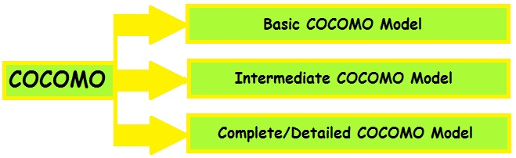


COCOMO
Types of Models: COCOMO consists of a hierarchy of three increasingly detailed and accurate forms. These are types of COCOMO model:

Slide 7

Function point analysis
Function Point Analysis - is a method of Functional Size Measurement. It assesses the functionality delivered to its users, based on the user’s external view of the functional requirements. It measures the logical view of an application as compared to measuring the physically implemented view or the internal technical view.
Brief History to Function Point Analysis. It was developed first by Allan J. Albrecht in the mid 1970s. It was an attempt to overcome difficulties associated with lines of code as a measure of software size, and to assist in developing a mechanism to predict effort associated with software development.

Slide 8
Function Point Analysis
Internal Logical File (ILF): User-identifiable group of related data maintained within the application.
External Interface File (EIF): Files passed or shared between software systems should be counted as external interface file types within each system.
External Input (EI): Count each unique input-output combination, where an input causes and generates an immediate output, as an external inquiry type.
External Output (EO): Unique elementary process that sends data outside the application boundary. Calculations, derivation of data, or maintenance also takes place.
External Inquiry (EQ): Unique elementary process that sends data outside the application boundary. Calculations, derivation of data, or maintenance do not take place.

Slide 9
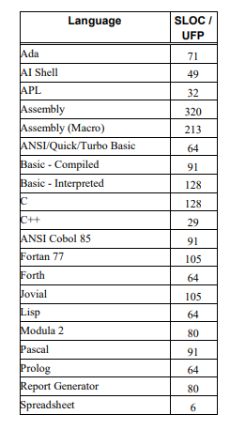
Combined methods
COCOMO II supports three estimation models: Application Composition,
Early Design, and Post-Architecture.
The Application Composition model: is used on projects that use I-CASE tools for rapid application development
The Early Design model: is used when there is only enough project information for a rough estimate
The Post-Architecture model: is used when most of the life-cycle architecture has been defined.
COCOMO II uses source lines of code (SLOC) and function points as its major size
measures. Because the number of delivered source instructions is the primary COCOMO
cost driver, function points have to be converted to SLOC before being used as input to
the model.

Slide 10
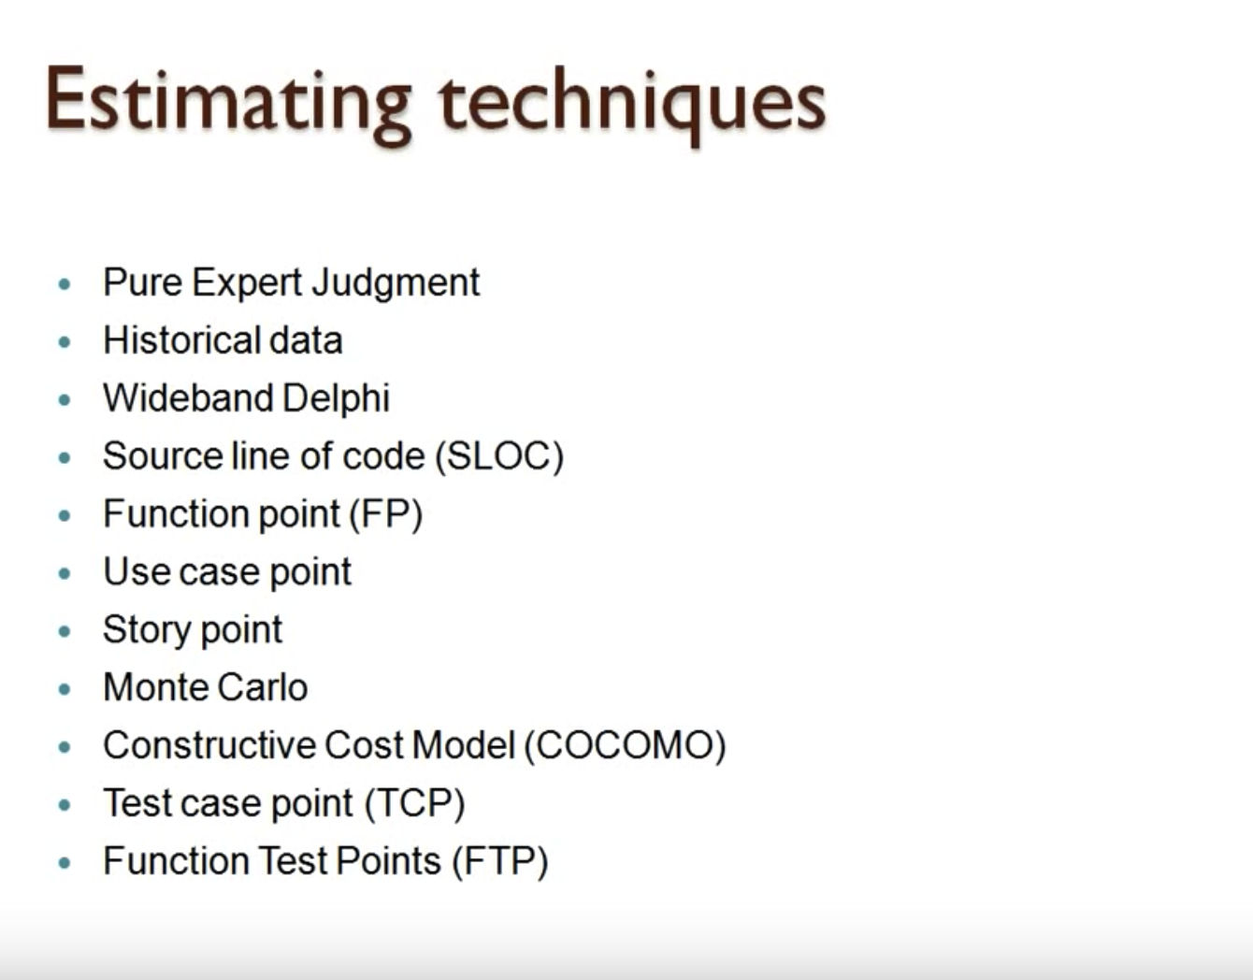

Slide 11
Difficulties
Data Availability (Correctness of Data)
Sensitivity Analysis
Insufficient Requirement
Environment Instability
Specification of Standard Rules

Slide 12
Implementation
Case Studies :
Clear Identification of Requirement
Availability of valid data
Standardized structure
Recognition of excluded cost
Provision for program uncertainty
Estimation Review for significant Project Changes

Slide 13
Agile Project Management (APM)
Agile Project Management (APM) is an iterative approach to planning and guiding project processes.
Used for large project
Initial specification unclear

Slide 14
Function point Analysis
A function point is a "unit of measurement" to express the amount of business functionality an information system (as a product) provides to a user.
The scope of the software development product (e.g. software units to be delivered or worked on)
Quality Management (e.g. the number of defects per software unit)
Productivity of the software
Performance (e.g. staff resources per software unit)

Slide 15
Any Questions…?
Thank You

